Slide 1

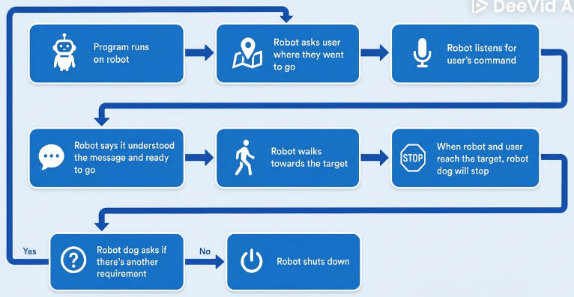
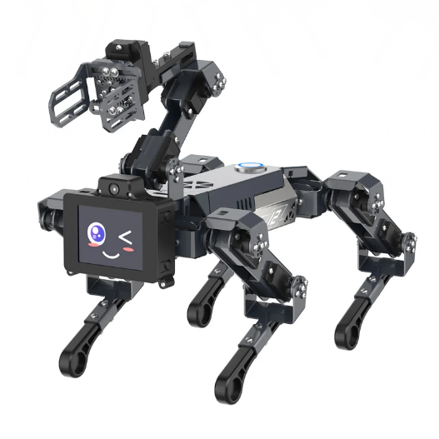
Human and Robot Interaction (HRI)
Robotic Dog Navigator for the Visually Impaired People
Idan Tobis
Nathan Beer and Tomer Bengayev
2026 Semester B תשפ"ו
Introduction
Methods
Motivation: We wanted our project to be helpful for people with certain needs, and we were thinking of people with vision difficulties, there are that can help them navigate, but even that has some problems
Dogs need their time for sleep or eat
Dogs cost a lot of money
Not every person can keep a dog, either because of allergies or doesn’t know how to train it
Project Goal: Develop a dog type robot that can solves these issues we presented and can help people with vision difficulties 24hrs a day.
Object Detection: Real-time identification using YOLO (You Only Look Once).
Image Processing: Frame analysis via OpenCV (cv2).
Pathfinding: Custom algorithmic computation for optimal navigation toward detected targets.
Speech Recognition: Uses OpenAI Whisper and sounddevice for accurate command parsing.
Spoken Feedback: gTTS (Google Text-to-Speech) for natural, conversational responses.
Data Processing: Efficient handling of audio streams and data via NumPy, scipy.io.wavfile, and standard OS utilities.
Workflow
Conclusions
Achieve Goal: We met our goal by developing a robotic dog that helps to navigate the visually impaired.
Seamless Integration: Successfully bridged the gap between high-level AI and low-level hardware control.
Libraries: We used YOLO for real-time image processing, whisper and speech_recognition for command processing, gTTS for voice feedback, and pathfinding with A* for navigation
Discussion
Future Work
Due to development timeline constraints, final physical chassis integration is pending; however, the system is fully operational at the software level.
In future work, we could bring the user with the robot dog outside and make the robot navigate the person from place to place safely and finds the best routes, help the person cross the road, get them to bus or train stations and tell them when to get on and when to get off. By all these features, the robot dog could be even more reliable and helpful than a normal dog.

